Slide 1





UE19CS390A – Capstone Project Review #3
(High Level Design and Proposed Methodology)
Project Title : Automated Billing cart
Project ID : 75
Project Guide : Prajwala T.R
Project Team :
PES2U1G9CS198 Kuntal Gorai
PES2UG19CS346 S V S C Santosh
PES2UG19CS391 Skanda S
PES2UG19CS454 Vijay Murugan A S

Slide 2
Outline
Abstract
Summary of Literature Survey
Suggestions from Review – 2
Proposed Methodology / Design Approach
Architecture
Design Description
Technologies Used

Slide 3

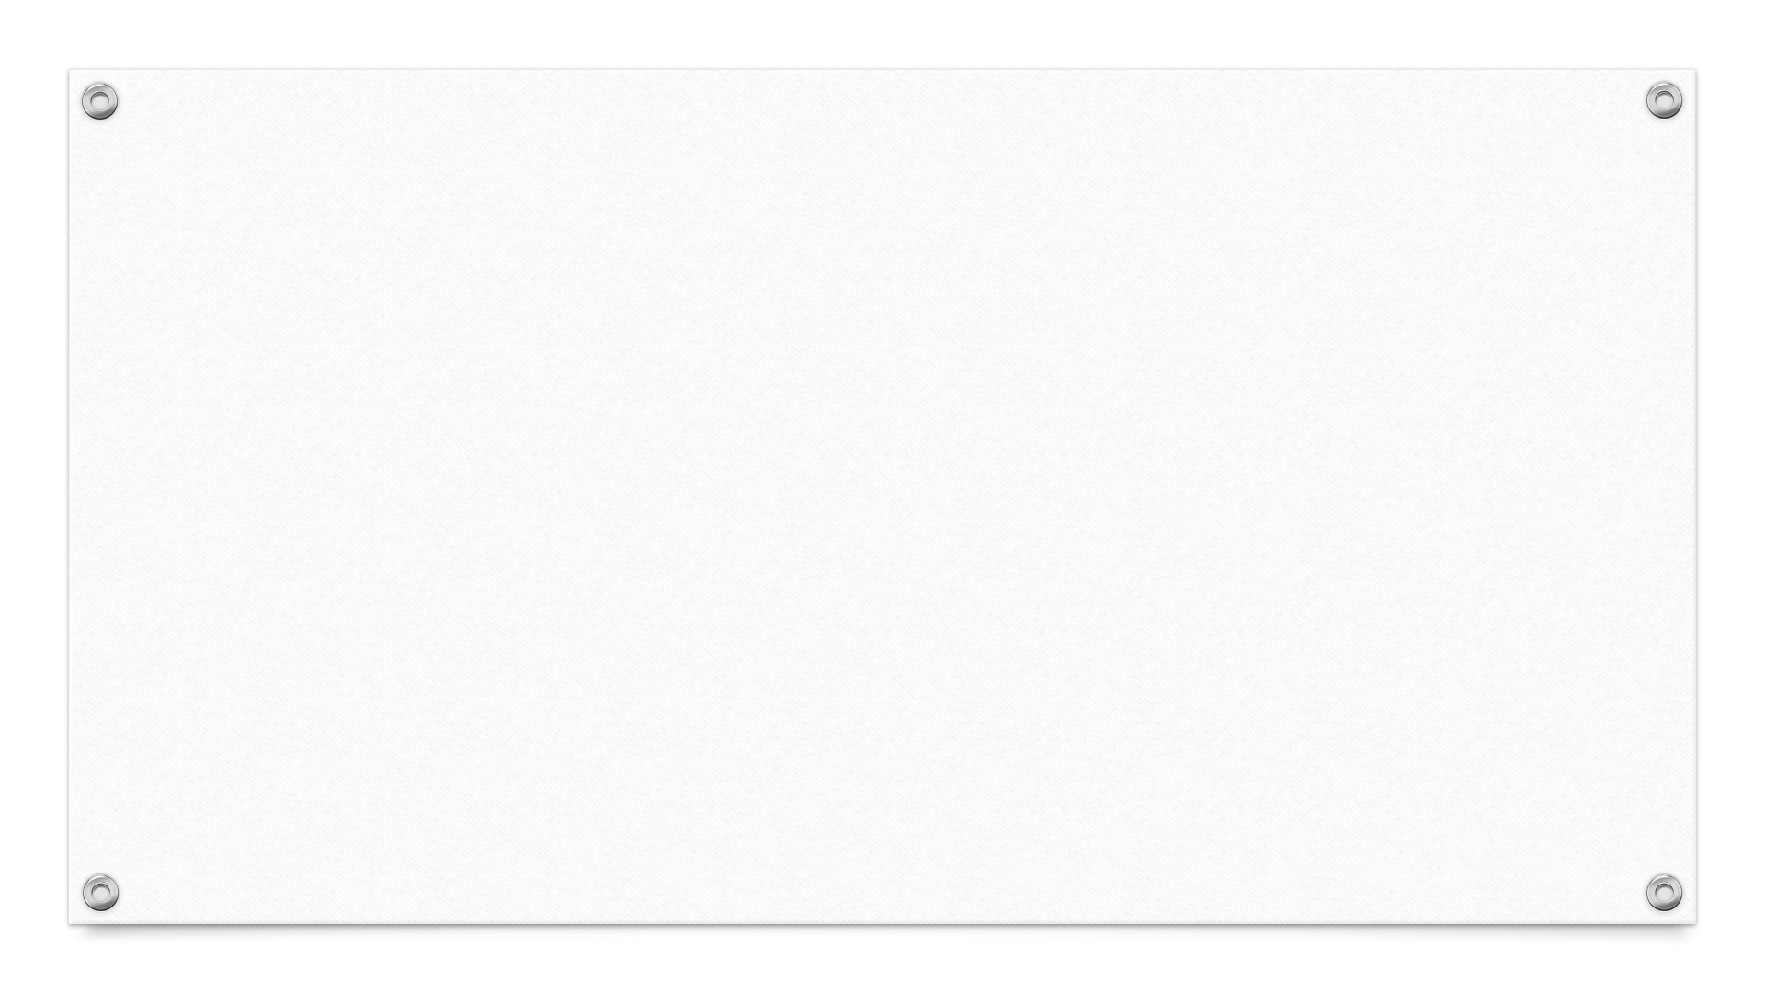
Abstract
Shopping malls have become an integral part of city life and a lot of people commute to these marts to get their daily essentials and groceries. However, we are all forced to go through the tedious task of getting our items billed. The billing phase is the one choke point every customer must pass through. Moreover, every customer takes a variable amount of time to get their items billed, causing huge queues. We aim to make this whole experience of shopping easier.

Slide 4
Problem Statement
•Standing in long queues is time consuming and tedious.
•This Project aims to design a system that detects and classifies the commodities placed into the shopping cart in a systematic manner using Deep Learning techniques.
•This system will add the item when placed into the cart and update the details of the items on the app, finally generating the bill.

Slide 5
Summary of Literature Survey in Review 2
^{[4]}Making use of Mobile NetV2 in order to build a transfer learning-based model for fruit classification.
^{[1]}Convert the pretrained model into a mobile device compatible file i.e., Protobuf file which is achieved using Dark Flow and OpenCV.
^{[1]}Once converted we pass this file to our android studio package where we use Tensor flow module to predict images.

Slide 6
Summary of Literature Survey in Review 2
^{[3]}Make use of android studio to develop a fully working application whose flow is from login/ signup to the payment section with several intermediate steps to generate a bill.
^{[5]}Experiment to measure the accuracy of load cells on static and walking loads.

Slide 7
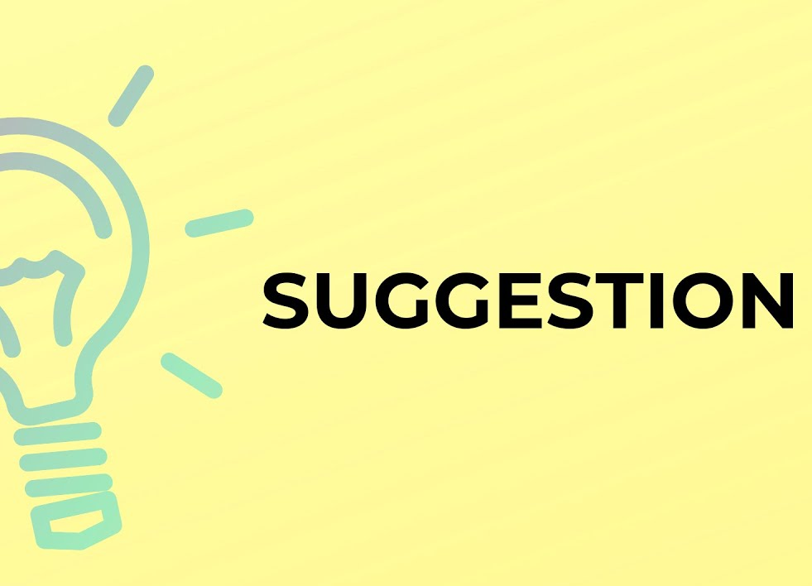
Suggestions from Review – 2
Suggestions from Review 2 :-
1) Explore more about the working of raspberry pi
2) Payments can be better handled by another third-party service because including the same would increase the project scope.
Progress on Suggestions:
Limiting our project to just the billing part where a final bill is generated and not thinking about payments.

Slide 8
Design Details
Novelty(What is unique about this idea?) :-All previous projects implemented made use of RFID tags which are attached to every item. Also, items like fruits and vegetables don’t always have an RFID tag that is considered in our project.
Innovativeness(What is new about our implementation?) :- Integrating transfer learning using MobileNetV2 in Android Studio with integration from continuous value from Arduino giving weights.

Slide 9
Design Details
Security (How well is our projected protected to ensure privacy):- Making use of Encryption and Decryption techniques to ensure the privacy of the user is protected. Only the admin of the Super Market would be able to modify the weights, price, and other necessary details of that supermarket. In the case Of payments, the use of already existing third-party service would deal with the total security of payments.
Reusability(How well can this application be used for other purposes):- The concept of using transfer learning enables us to reuse the model developed for any other classification task which could easily enable our app to solve any classification problem easily.

Slide 10


Design Details
Reliability(How does the proposed model perform consistently well?):- To ensure optimum reliability, we attempt to construct the model with high precision and low latency.
Performance(How well does the proposed model execute a function?):- We aim to train the model to be able to classify the provided item in 3-4 seconds with an accuracy of at least 90%.

Slide 11
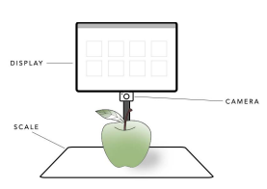
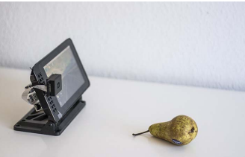
Proposed Methodology / Approach
Make use of Mobile Net V2 to develop a model for classification of the required item.
Load that model into a mobile where weights can be stored into a protobuf file which can be used for classification of the required items.
Get weight from load cell of arduino which can then be used to obtain desired cost of each bill.
Generate the bill finally.
Model | With Plastic Bag |  | Without Plastic Bag
 | Train | Test | Train | Test
Mobile Net V2 | 0.98 | 0.78 | 0.99 | 0.82

Slide 12
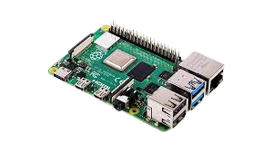
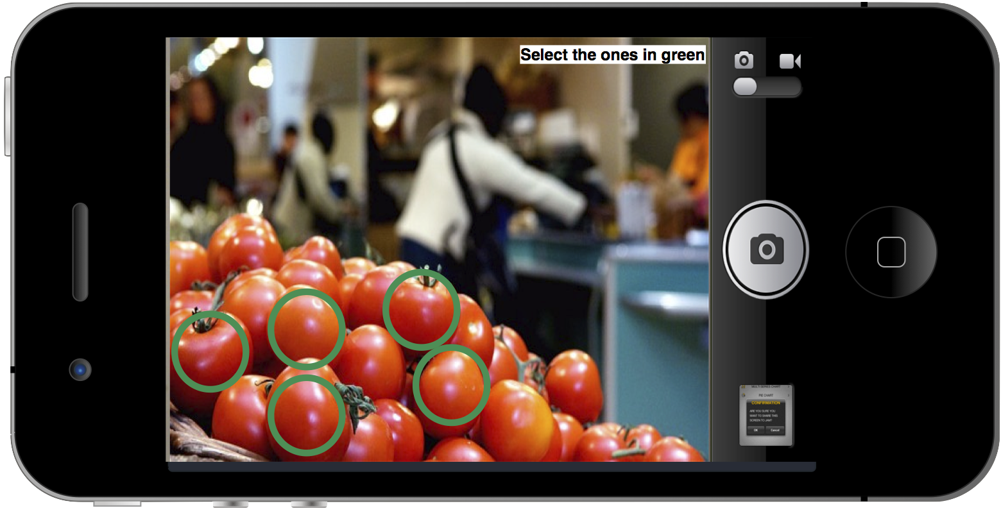


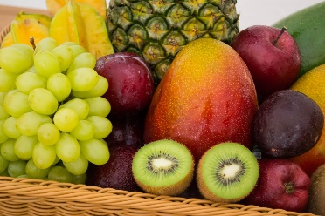
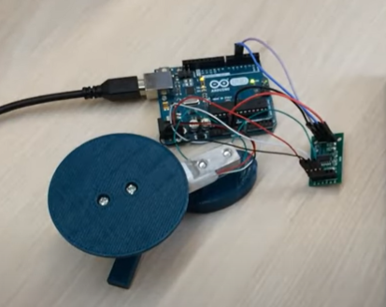
Architecture
Camera
Database
Arduino/Raspberry Pi
App
Items in the cart
Load Cell

Slide 13
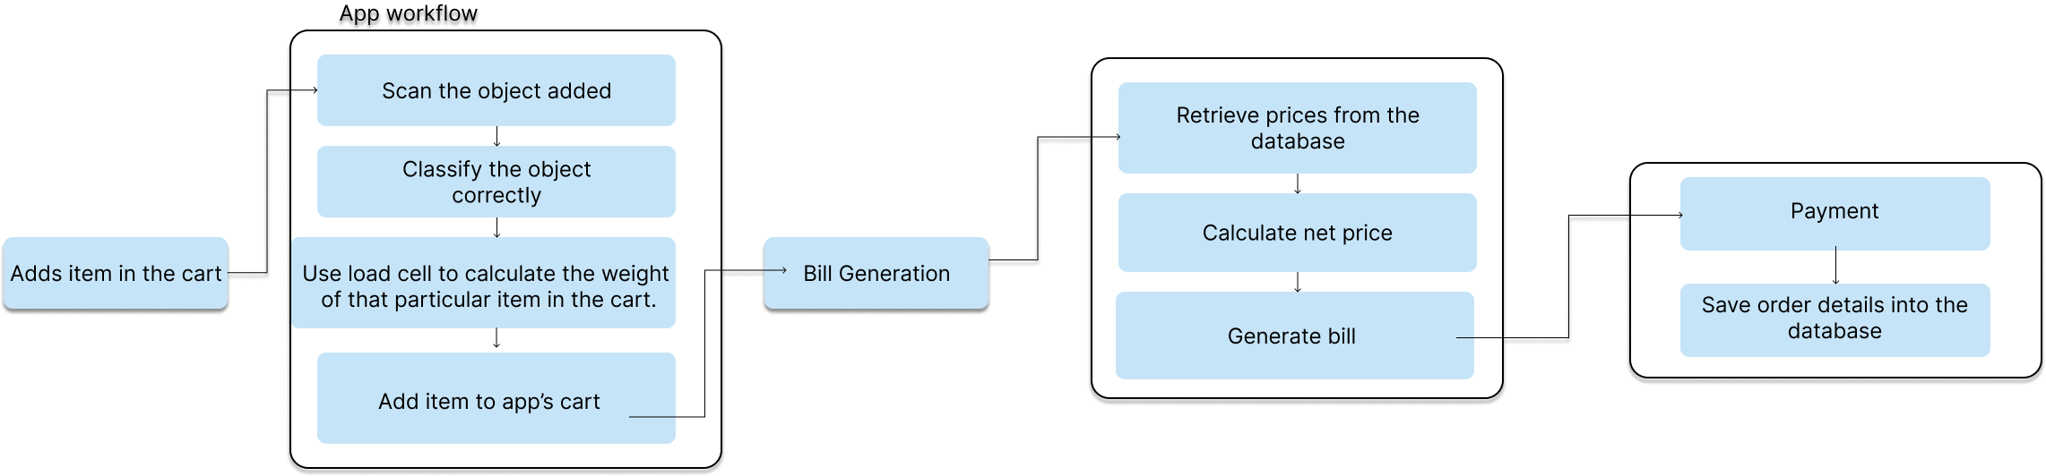
Architecture

Slide 14
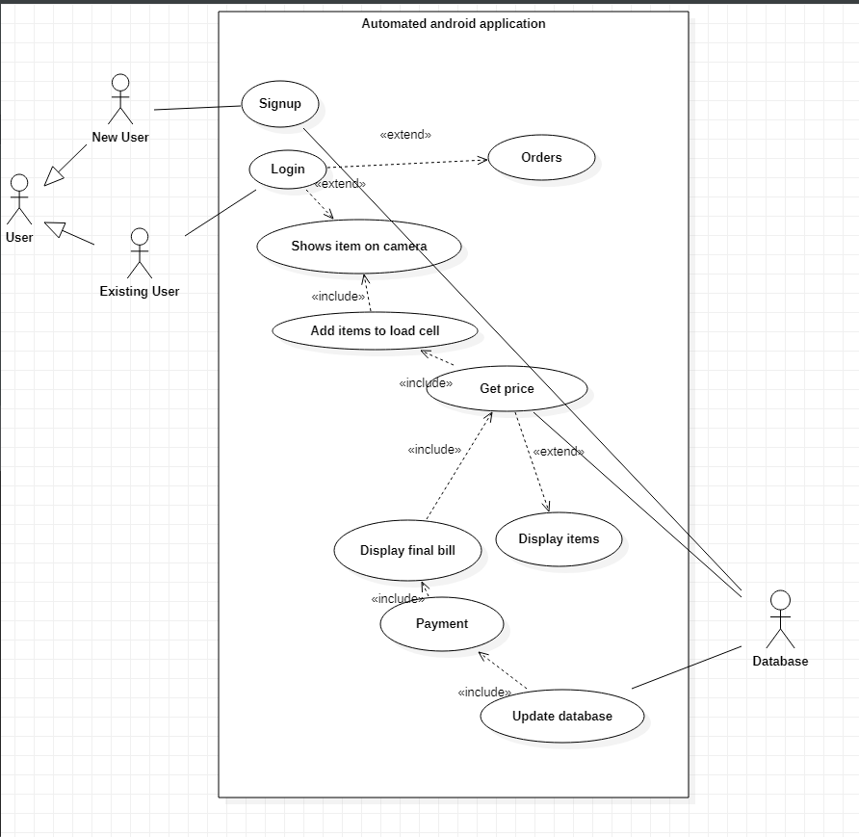
Design Description: Use Case Diagram

Slide 15
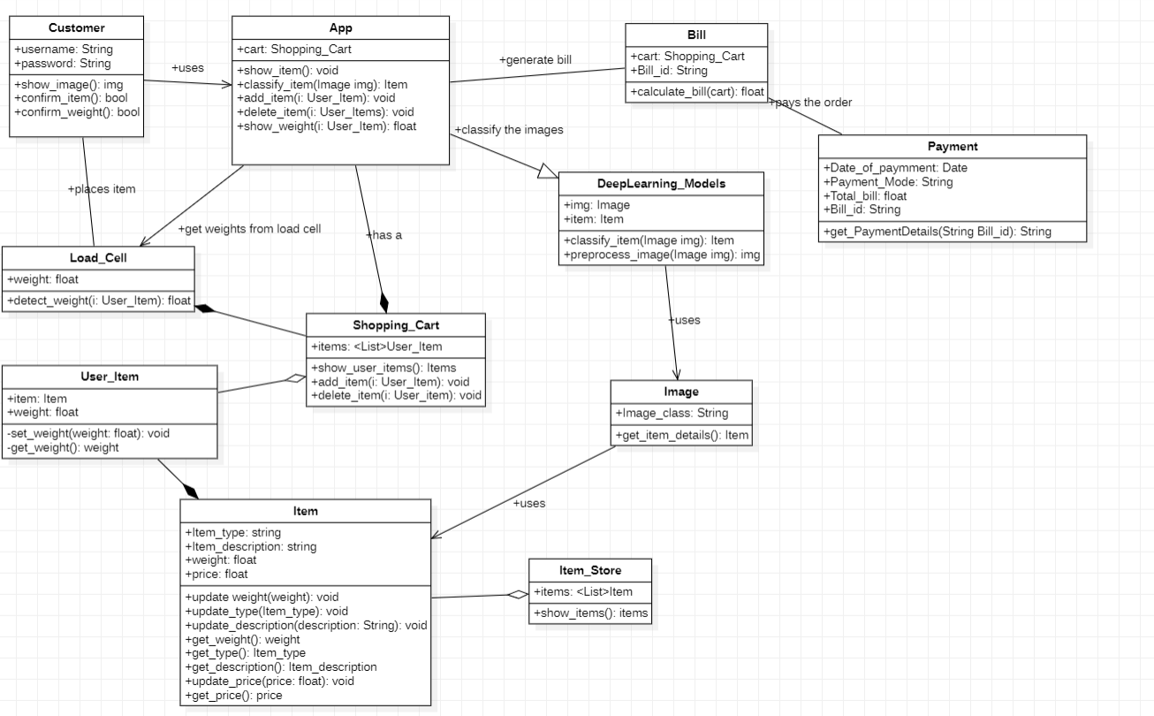
Design Description: Class Diagram

Slide 16
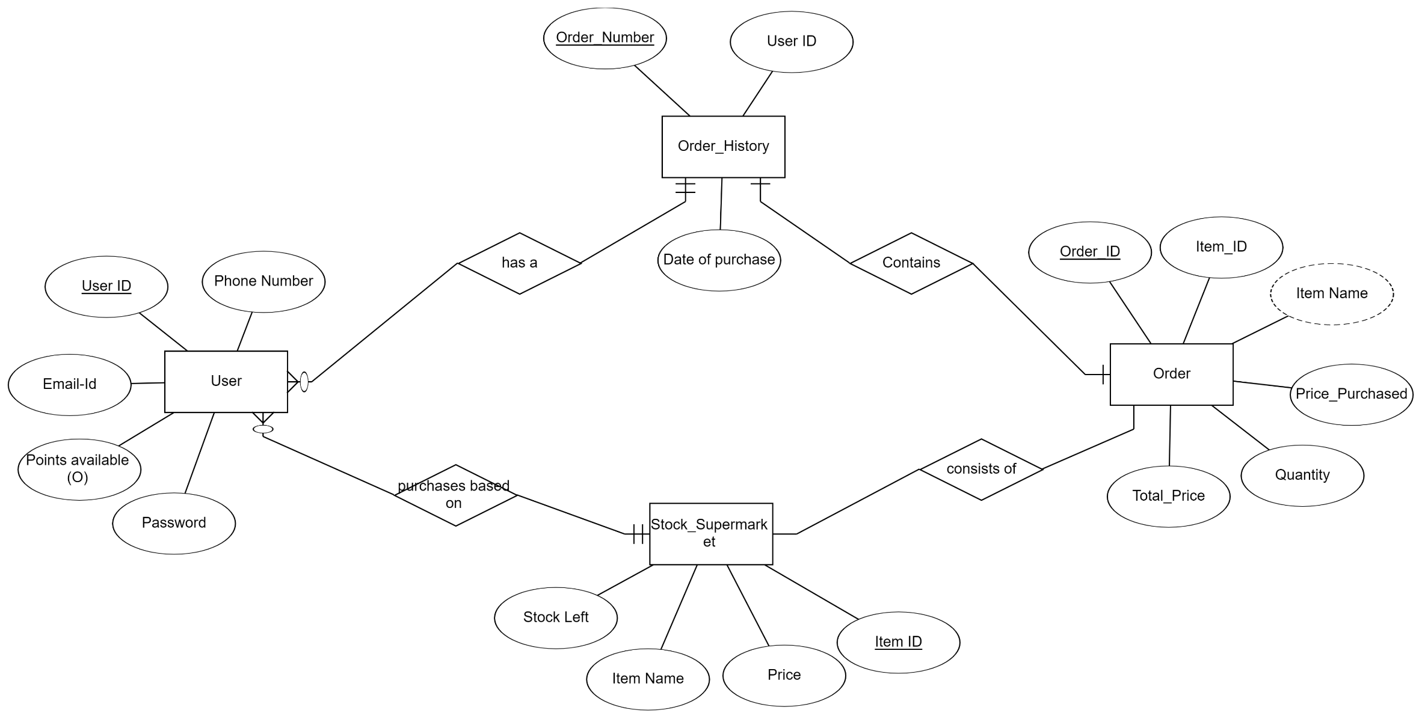
Design Description: ER Diagram

Slide 17


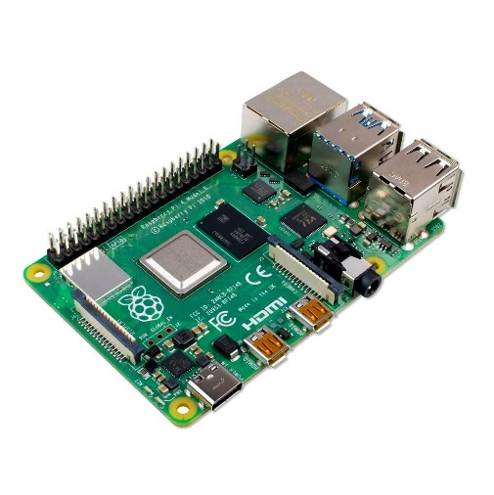

Technologies Used
Tensor flow and Keras to develop our model.
Google Collab/ Jupyter Notebook.
Protobuf to store weights of the model being developed.
Android Studio to develop an application.
Arduino/Raspberry Pi and its necessary components like load cell.

Slide 18

Project Progress
Problem statement decided.
Dataset Acquisition
Apply some machine learning model to our dataset obtained.
Implement MobileNet V2 as a classification task.
High-Level Design

Slide 19
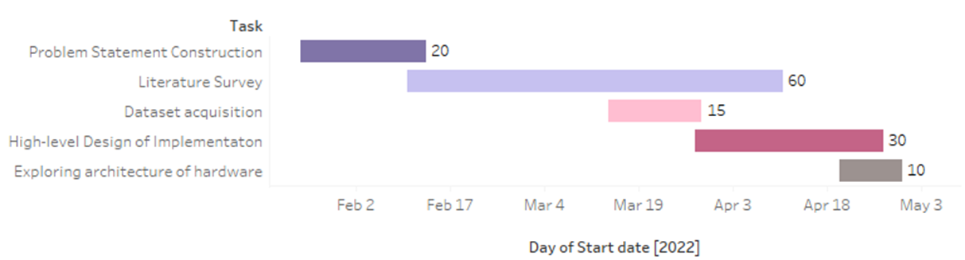
Capstone (Phase-I & Phase-II) Project Timeline
Phase 1
The work is distributed equally amongst ourselves for each task in the first phase.

Slide 20
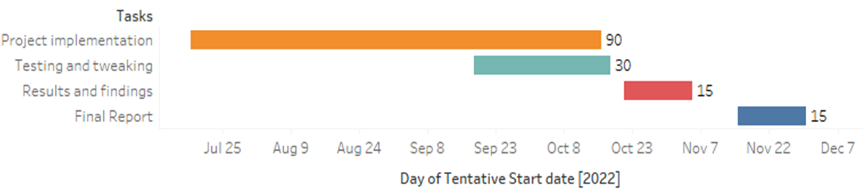
Capstone (Phase-I & Phase-II) Project Timeline
Phase 2

Slide 21
References
Deployment of Deep Learning Models on Resource-Deficient Devices for Object Detection Ameema Zainab & Dabeeruddin Syed - 2020
A Hierarchical Grocery Store Image Dataset with Visual and Semantic Labels Marcus Klasson, Cheng Zhang & Hedvig Kjellstrom - 2019
Android Application for Grocery Ordering System Shubham B Dubey, Gaurav M Kadam & Omkar Angane - 2021
Fruit Classification for Retail Stores Using Deep Learning Jose Luis Rojas-Aranda, Jose Ignacio Nunez-Varela, J. C. Cuevas-Tello &Gabriela Rangel-Ramirez - 2020
5. Cross Validation Voting for Improving CNN Classification in Grocery Products (2022),
Jamie Duque Domingo , Roberto Medina Aparicio , and Luis Miguel Gonzalez Rodrigo

Slide 22
